Slide 1

Leveraging Blockchain Technology for Secure Data Sharing in Cloud Environments

Slide 2

Contents
INTRODUCTION
LITERATURE REVIEW
BLOCKCHAIN FOR DATA SHARING
CHALLENGES AND LIMITATIONS
MARKET POTENTIAL OF BLOCKCHAIN IN SECURE DATA SHARING
CONCLUSION

Slide 3

Introduction
Background on Cloud Computing and Data Security Limitations
Cloud computing has transformed the way organizations store, process, and access data.
However, traditional cloud storage models have inherent security vulnerabilities, including data breaches and unauthorized access.
Introduction to Blockchain Technology and Core Features
Blockchain technology offers a decentralized and secure approach to data management.
Core features include decentralization, immutability, and transparency, which address the limitations of centralized cloud storage.

Slide 4
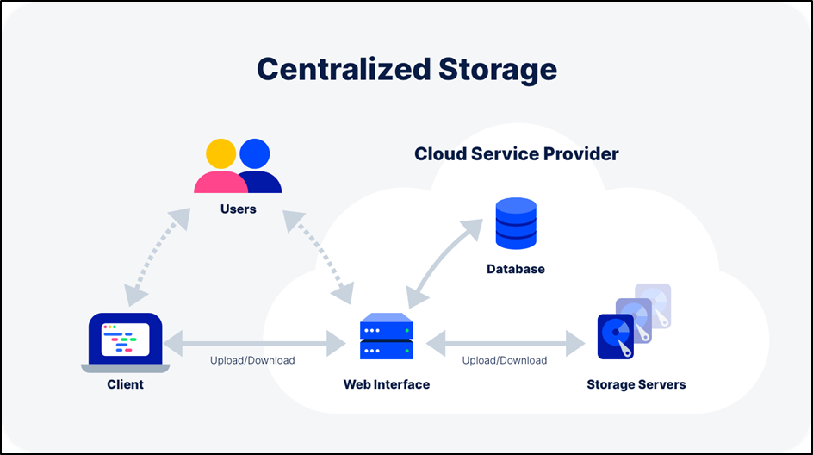
Background of Centralized Storage

Slide 5
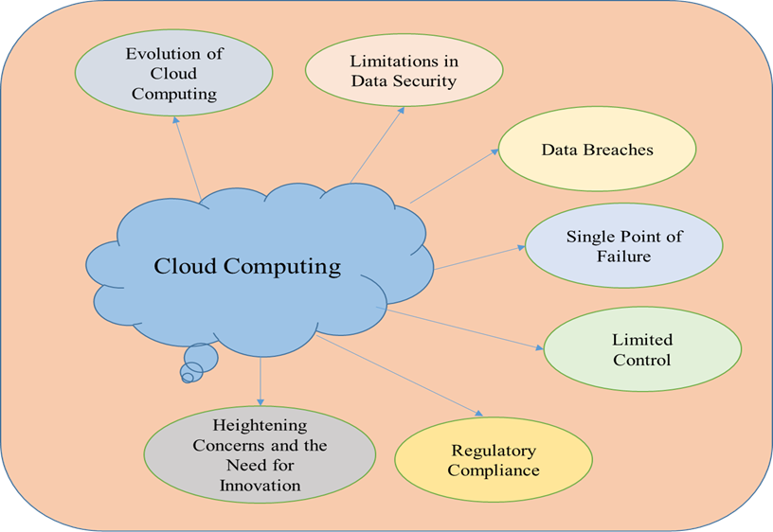
Cloud Computing Limitations in Data Security

Slide 6

Problem Statement: Need for Secure Data Sharing in Cloud Environments
The increasing reliance on cloud computing necessitates robust data security measures.
Organizations face challenges in ensuring secure data sharing, especially in multi-party collaboration scenarios.
Project Objectives: Analyzing the Potential of Blockchain for Secure Data Sharing
The primary objective of this project is to explore how blockchain technology can enhance data security in cloud environments.
We aim to analyze the potential benefits, challenges, and applications of blockchain for secure data sharing.

Slide 7
Literature Review
Existing Research on Blockchain-Based Secure Data Sharing
Numerous studies have explored the use of blockchain technology for secure data sharing in various domains.
Research highlights the potential of blockchain in enhancing data security, transparency, and auditability in cloud environments.
Applications of Blockchain in Secure Data Sharing
Blockchain finds applications in diverse sectors such as healthcare, finance, supply chain management, and more.
Examples include secure health data exchange, transparent financial transactions, and traceable supply chain management.

Slide 8

Analysis of Strengths and Weaknesses of Existing Approaches
Current approaches to blockchain-based secure data sharing exhibit strengths such as enhanced security, transparency, and resilience.
However, challenges like scalability, integration complexity, and regulatory compliance pose limitations to widespread adoption.

Slide 9

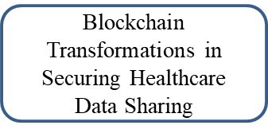

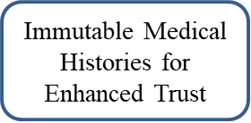
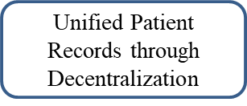
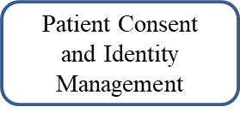
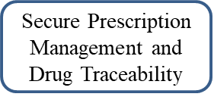
Blockchain of Healthcare

Slide 10
Blockchain for Secure Data Sharing
Key Mechanisms of Blockchain for Secure Data Sharing
01
Access Control and Permissions: Govern data access and ensure only authorized parties can interact with shared data.
02
Data Encryption and Tamper-Proof Storage: Encrypt data and store it in an immutable ledger, preventing unauthorized alterations.
03
Auditability and Transparency: Maintain a transparent record of data interactions, facilitating auditing and ensuring accountability.
04

Slide 11
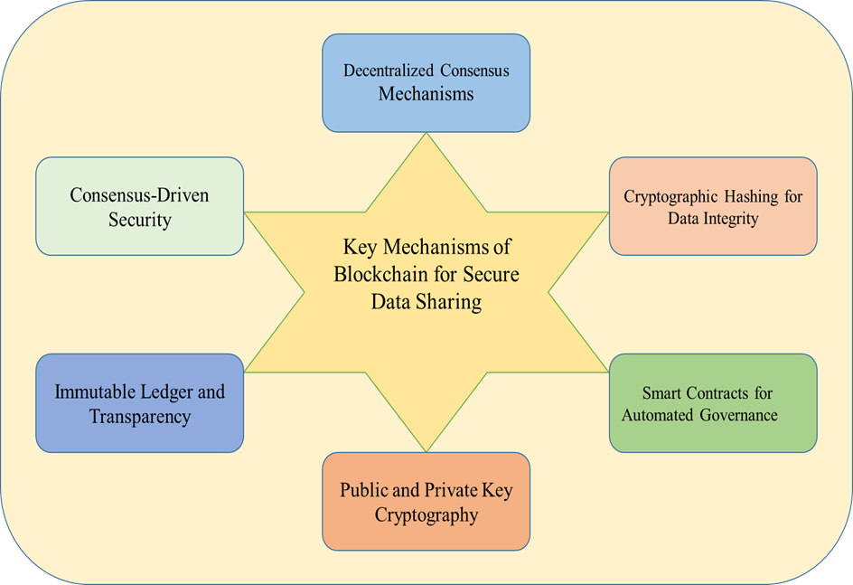
Mechanism of Blockchain for Secure Data Sharing

Slide 12
Potential Benefits of Using Blockchain
Enhanced Security and Privacy: Decentralized architecture and cryptographic principles bolster data security and privacy.
Increased Trust and Transparency: Immutable ledger and transparent record of transactions foster trust among participants.
Improved Data Traceability and Accountability: Traceability of data interactions enhances accountability and enables better tracking of data provenance.

Slide 13

Challenges and Limitations
Scalability and Performance Limitations of Blockchain Technology
Addressing the challenges associated with scaling blockchain networks to accommodate growing data volumes and transaction throughput.
Regulatory and Legal Considerations of Blockchain-Based Data Sharing
Ensuring compliance with existing regulations such as GDPR, CCPA, and industry-specific laws when implementing blockchain solutions for data sharing.
Integration Challenges with Existing Cloud Infrastructure
Overcoming complexities in integrating blockchain technology with traditional cloud infrastructure, including data storage and processing systems.

Slide 14
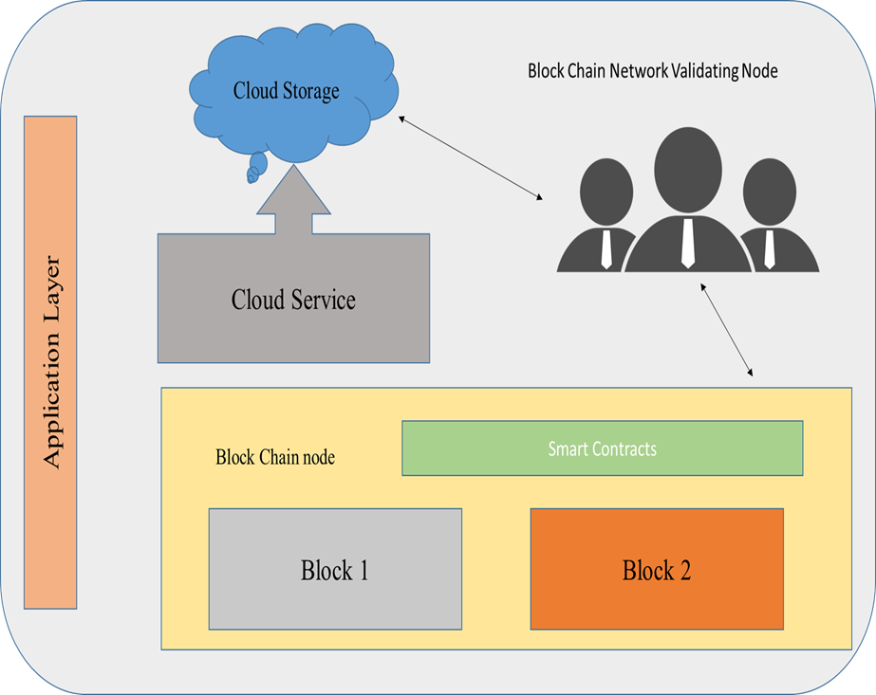
Architecture of Blockchain in Cloud Environment

Slide 15

Market Potential of Blockchain in Secure Data Sharing
Drivers for Adoption
Highlighting the factors driving the adoption of blockchain technology for secure data sharing, including concerns over data security in cloud environments, regulatory compliance requirements, and increasing industry interest.
Data Security Concerns in Cloud Environments
Discussing the escalating data security concerns in cloud computing and how blockchain offers solutions to mitigate these risks through decentralization, encryption, and transparency.

Slide 16
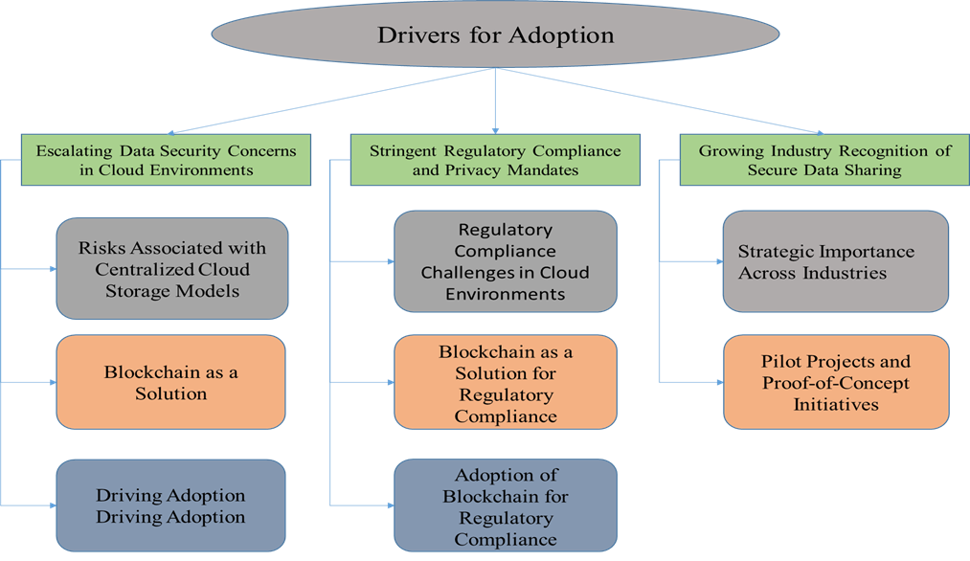
Drivers for Adoption

Slide 17
Regulatory Compliance and Privacy Mandates
Exploring the role of blockchain in helping organizations adhere to stringent data privacy regulations such as GDPR and CCPA, ensuring compliance and maintaining data integrity.
Industry Interest in Secure Data Sharing
Analyzing the growing interest across industries in adopting blockchain for secure data sharing, driven by the need for innovation, collaboration, and operational efficiency.

Slide 18
Current Industry Trends
Providing insights into the current trends in industries such as healthcare, finance, supply chain management, and education, where blockchain is being increasingly utilized for secure data sharing.
Case Studies of Successful Implementations
Showcasing real-world examples of successful implementations of blockchain technology for secure data sharing, demonstrating its effectiveness in various sectors through case studies and use cases.

Slide 19
Conclusion
Summary of Findings and Key Takeaways
Summarizing the key findings and insights obtained throughout the study, including the potential of blockchain technology for secure data sharing in cloud environments, the challenges faced, and the opportunities identified.
Reiteration of the Project's Value Proposition
Reinforcing the value proposition of the project, emphasizing its contribution to enhancing data security, ensuring regulatory compliance, and fostering industry interest in secure data sharing through blockchain technology.

Slide 20
Recommendations for Future Development and Application
Providing recommendations for future development and application of blockchain-based solutions for secure data sharing in cloud environments. This may include suggestions for further research, technology improvements, and collaborative initiatives to address existing challenges and maximize the potential of blockchain in this domain.

Slide 21
REFERENCES
REFERENCES
[1] Sehgal, N.K., Bhatt, P.C.P. and Acken, J.M., 2020. Cloud computing with security. Concepts and practices. Second edition. Switzerland: Springer.
[2] Sehgal, Naresh Kumar, Pramod Chandra P. Bhatt, and John M. Acken. "Cloud computing with security." Concepts and practices. Second edition. Switzerland: Springer (2020).
[3] Gupta, Sourav Sen. "Blockchain." IBM Onlone (http://www. IBM. COM) (2017).
[4] Uriarte, Rafael Brundo, and Rocco DeNicola. "Blockchain-based decentralized cloud/fog solutions: Challenges, opportunities, and standards." IEEE Communications Standards Magazine 2, no. 3 (2018): 22-28.
[5] Botta, Alessio, Walter De Donato, Valerio Persico, and Antonio Pescapé. "Integration of cloud computing and internet of things: a survey." Future generation computer systems 56 (2016): 684-700.
[6] Singh, Vineeta, and Vandana Dixit Kaushik. "Navigating the Landscape of Security Threat Analysis in Cloud Computing environments." In Security and Risk Analysis for Intelligent Cloud Computing, pp. 1-25. CRC Press, 2024.
[7] Essah, Richard. "The Role of Cloud Computing Fashionable the Strategic Growth of Business Enterprises in India." Asian Journal of Research in Computer Science 12, no. 1 (2021): 37-48.
[8] Shrivastava, Pranav, Bashir Alam, and Mansaf Alam. "A hybrid lightweight blockchain based encryption scheme for security enhancement in cloud computing." Multimedia Tools and Applications 83, no. 1 (2024): 2683-2702..
[9] Ahmadi, Sina. "Security Implications of Edge Computing in Cloud Networks." Journal of Computer and Communications 12, no. 02 (2024): 26-46
[10] Ponnusamy, Sivakumar, and Pankaj Gupta. "Scalable Data Partitioning Techniques for Distributed Data Processing in Cloud Environments: A Review." IEEE Access (2024).

Slide 22
Contribution of team members
Yogi Bapiraju Raghavendra Bolla
• Research and Analysis: Conducted a detailed review of blockchain technology applications in secure data sharing, including existing frameworks and case studies.
• Technical Implementation: Worked on designing the blockchain architecture for the cloud environment, focusing on mechanisms like encryption, access control, and auditability.
• Documentation: Drafted sections of the project report, particularly the technical aspects and challenges, and contributed to creating visual aids like diagrams and charts.
Chandra Sekhar Kanaparthi
• Market Research: Analyzed industry trends, drivers for adoption, and regulatory compliance requirements relevant to blockchain in secure data sharing.
• Integration and Feasibility Study: Evaluated the practical integration of blockchain technology with existing cloud systems, identifying potential bottlenecks and solutions.
• Presentation Development: Prepared the slides and narrative for the final project presentation, emphasizing key findings, benefits, and recommendations.

Slide 23
THANK You

